Slide 1

Classes and Objects
bit.ly/aia3-oop
What are these new terms?

Slide 2
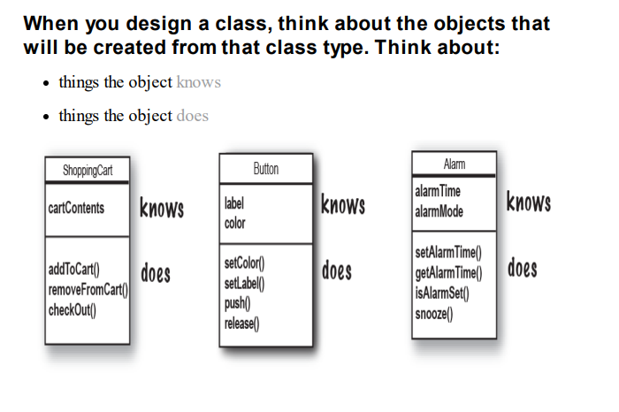
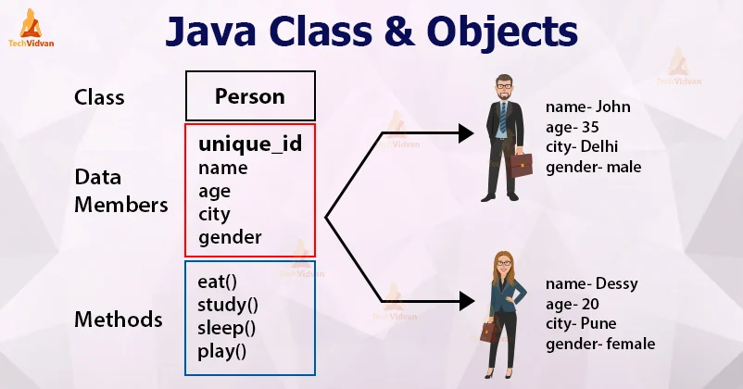

Slide 3
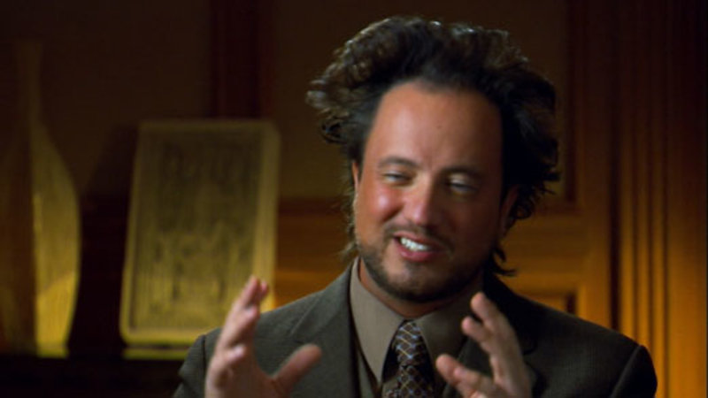
Do we really need this?

Slide 4
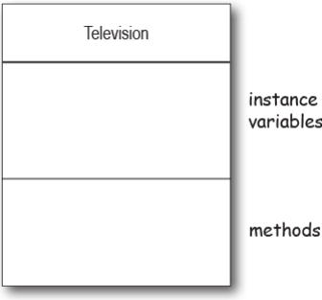
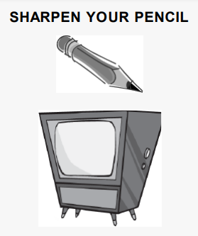
Notes:
Let’s do a brain storm session to think about the what instance variable and methods should a TV have

Slide 5
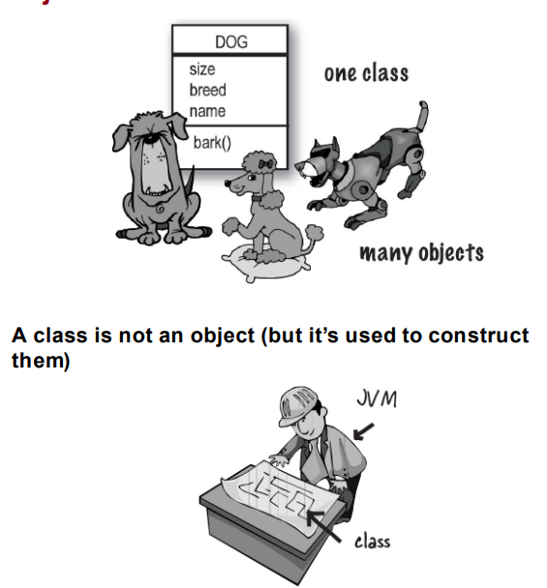
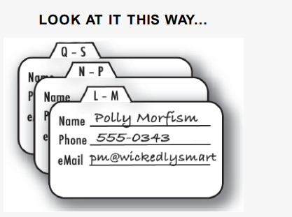
Notes:
We have the classic dog class and objects Then the contact list where the class is the shape a contact can be (name, number, email …) and the objects are the actual contacts that we use

Slide 6
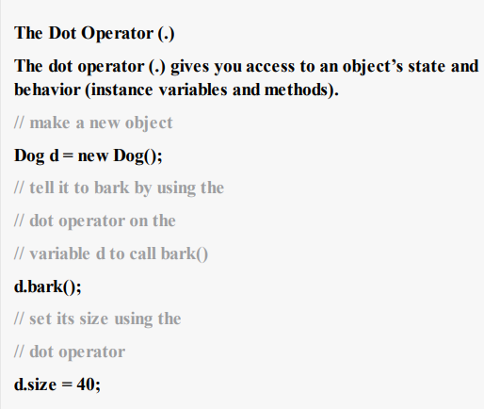
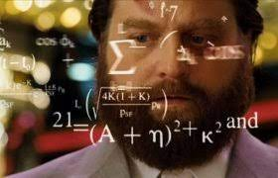
Creating
an object
How does the NEW keyword work ?

Slide 7
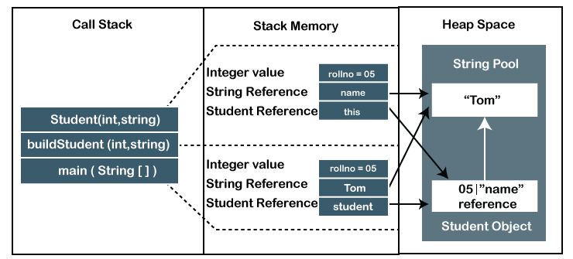
“New” behind the scenes
Notes:
Get a pause here and discuss it or maybe even draw it

Slide 8

frm.tv/join
BNX7VL
Notes:
https://app.formative.com/formatives/632b57d8f233cb2a47c0f66a/results
TX3B6A gr 2
Z29TPC gr1

Slide 9
TODO
Continue work on Java for beginners
Complete 3rd Chapter (Objects and Methods)
Exercise skills in Intellij

